Slide 1
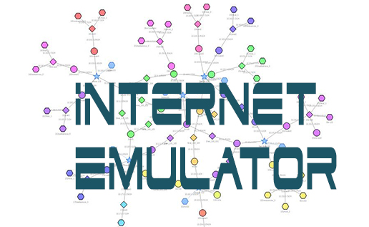
Building an Internet Emulator for Cybersecurity Education
Wenliang (Kevin) Du
Syracuse University

Slide 2
Outline
Motivation for this project
The design ideas
The emulator details
Applications: Labs
BGP attack lab
Morris worm attack lab
Demos

Slide 3
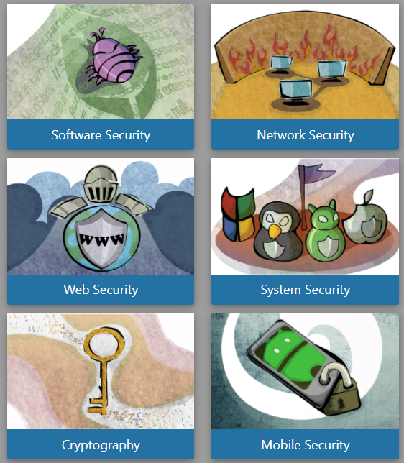
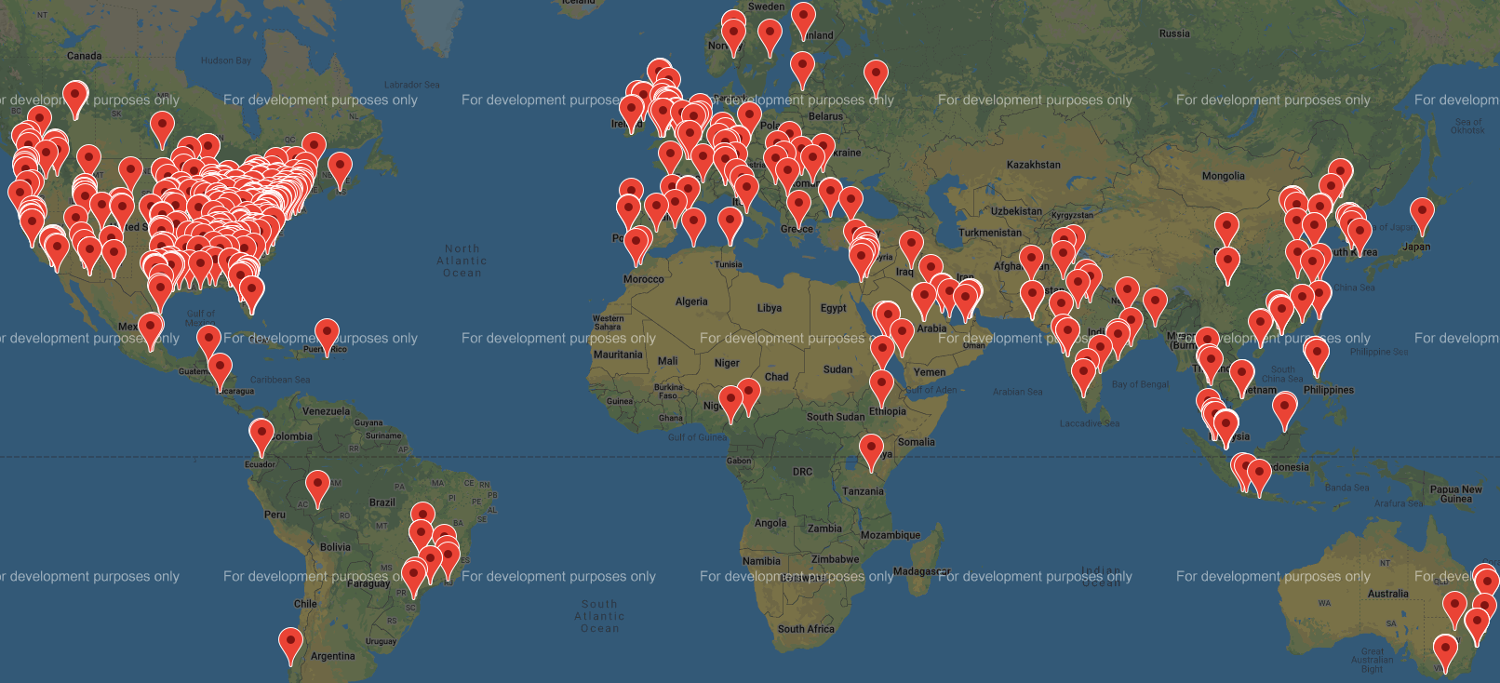
Motivation
https://seedsecuritylabs.org/
Adopted by 1000 institutes

Slide 4
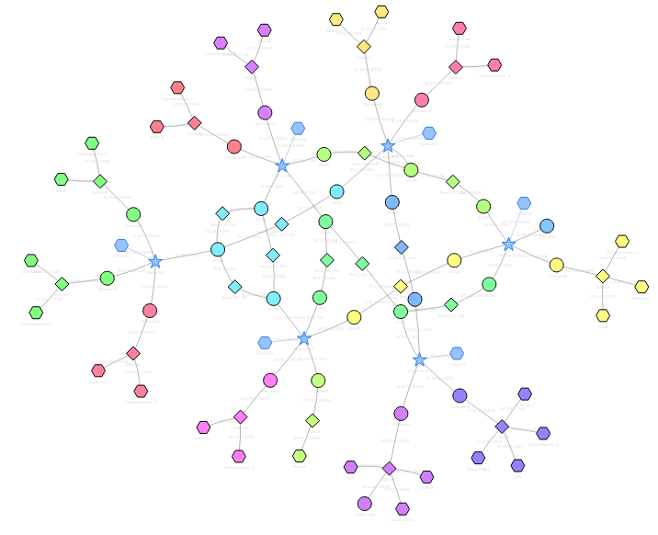
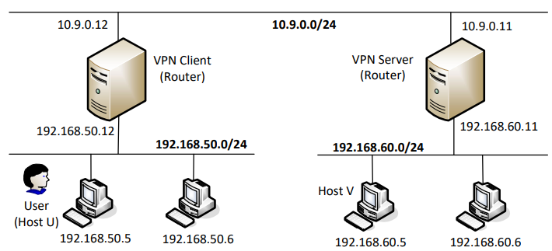
Limitations
SEED Labs 1.0: Using VMs
SEED Labs 2.0: Using docker containers

Slide 5
The Open-Source Project
Founders
Kevin Du
Honghao Zeng (MS student)
History
2018 – 2020: Investigation & Design
August 2020: Implementation
July 2021: First release
https://github.com/seed-labs/seed-emulator

Slide 6
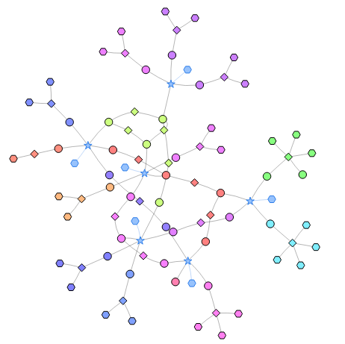
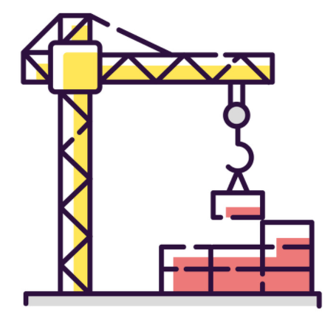
The Most Important Design Decision
Building Emulation
Conducting Emulation

Slide 7
Existing Work
CORE: Common Open Research Emulator
Based on Linux namespace
GNS-3: Graphical Network Simulator-3
Focus on network emulation, not Internet
Good at emulating vendor-specific network devices
NS-3
A simulator, not an emulator
Good at simulating network technologies
Not transparent to applications

Slide 8
Our Approach
Using Docker for emulation
Our job: compose the emulation
Constructing docker files

Slide 9
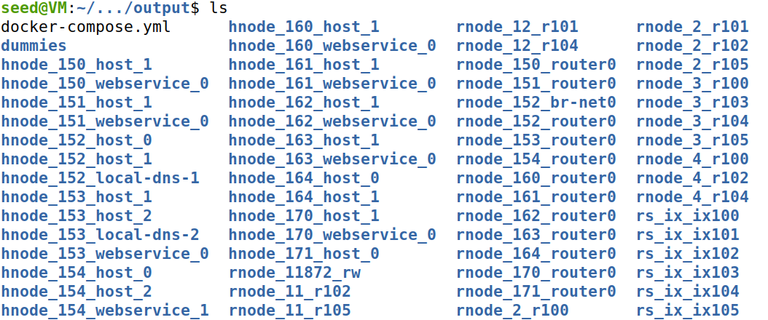
Building Emulation

Slide 10
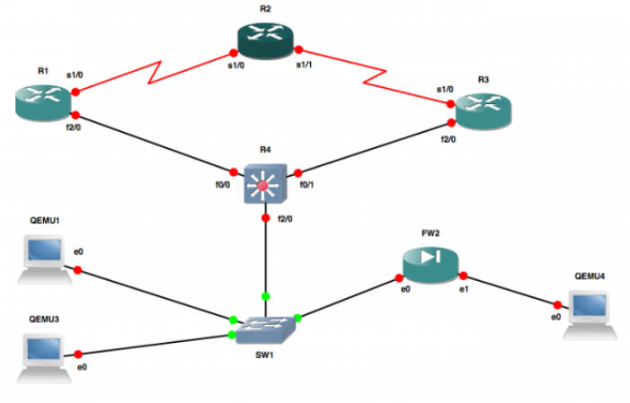
Different Approaches
GUI Approach
Configuration Approach (JSON, YAML)
Programming Approach
GNS3
What they have in common: language

Slide 11
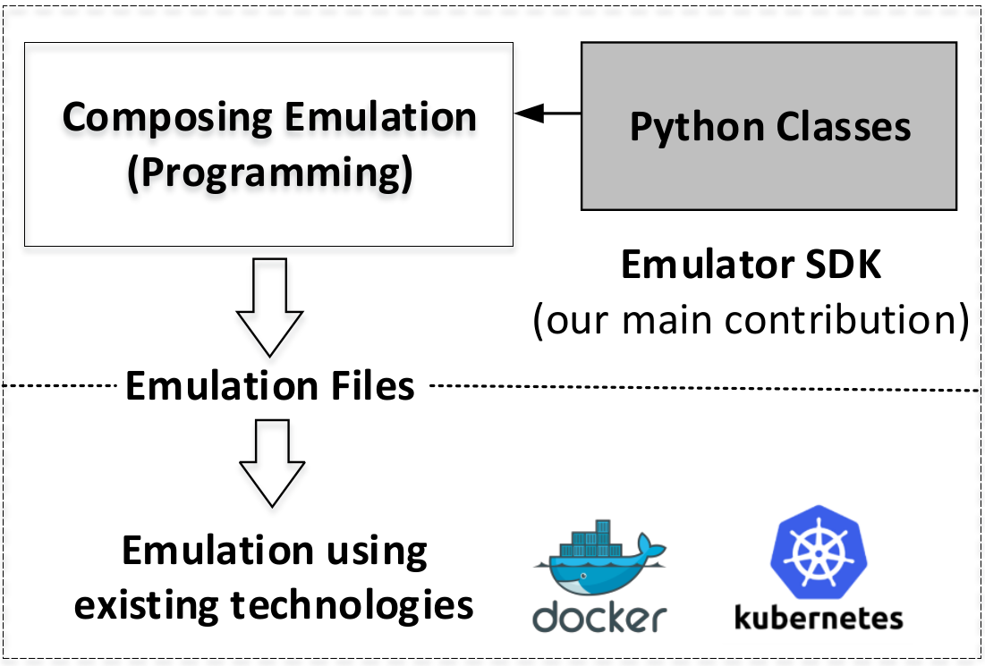
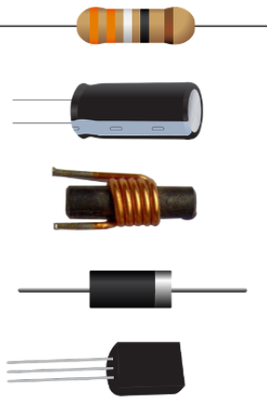
Our Design
Primitives (Classes)
Autonomous System
Internet Exchange
Network
Router, BGP speaker
Host
Service
etc.

Slide 12
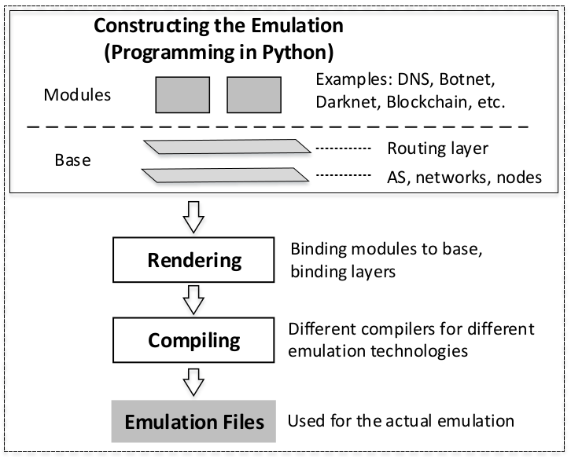
The Architecture

Slide 13
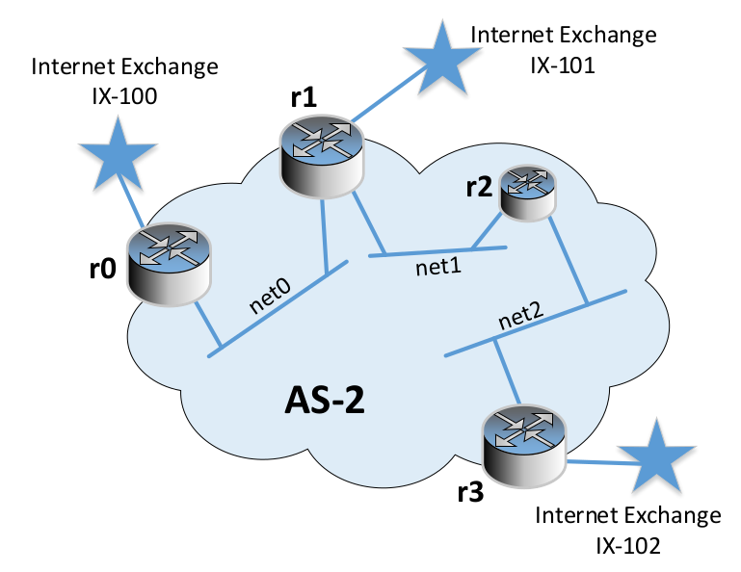
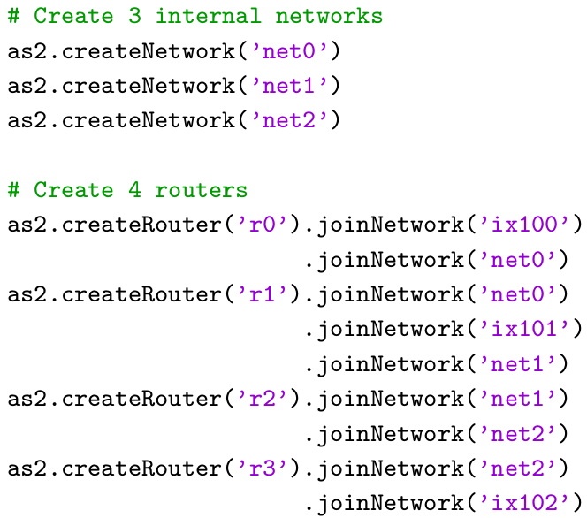
Example: Create a Transit AS

Slide 14
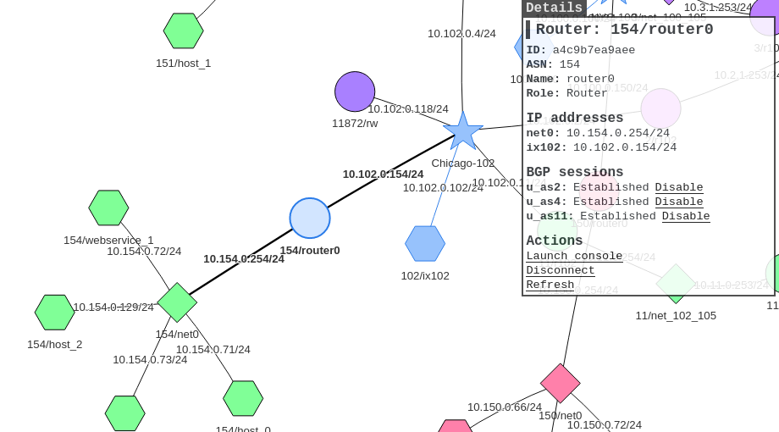
Example: BGP Peering

Slide 15
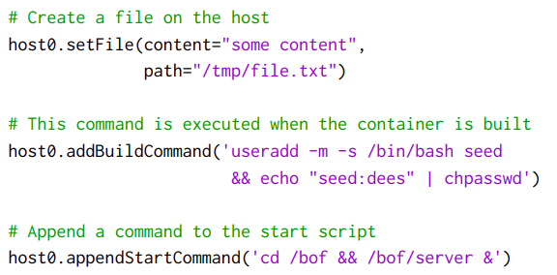
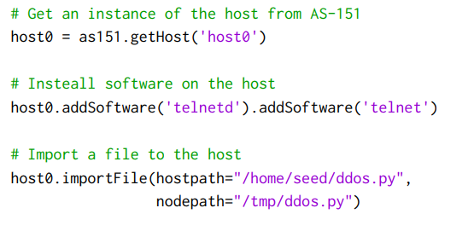
Customizing Nodes

Slide 16
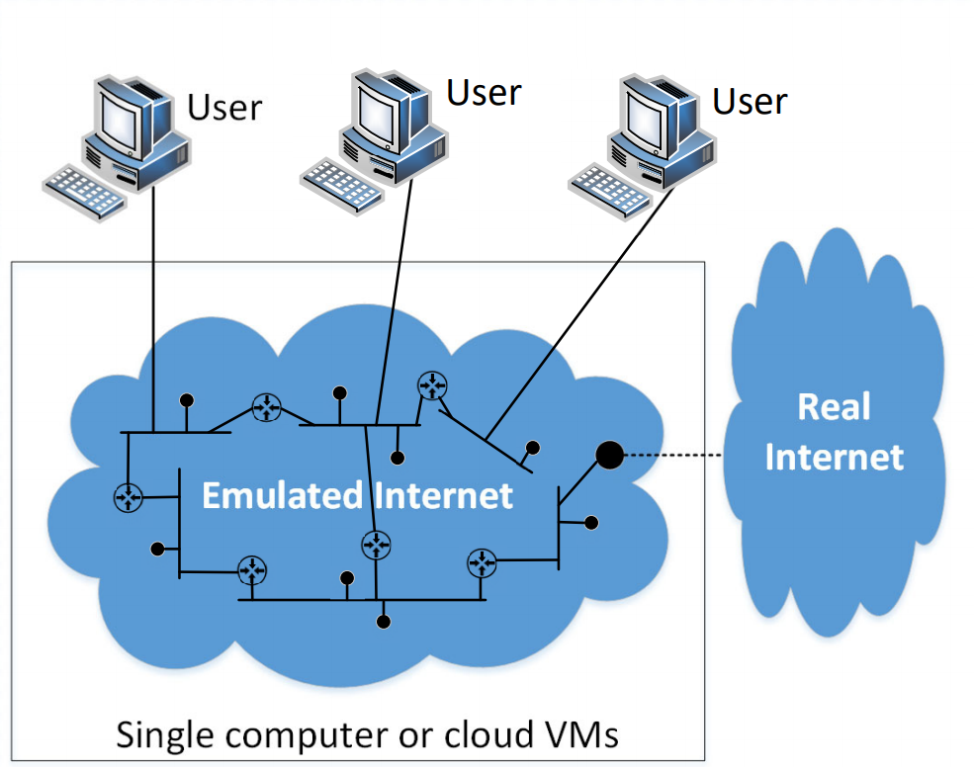
Shadow Internet

Slide 17
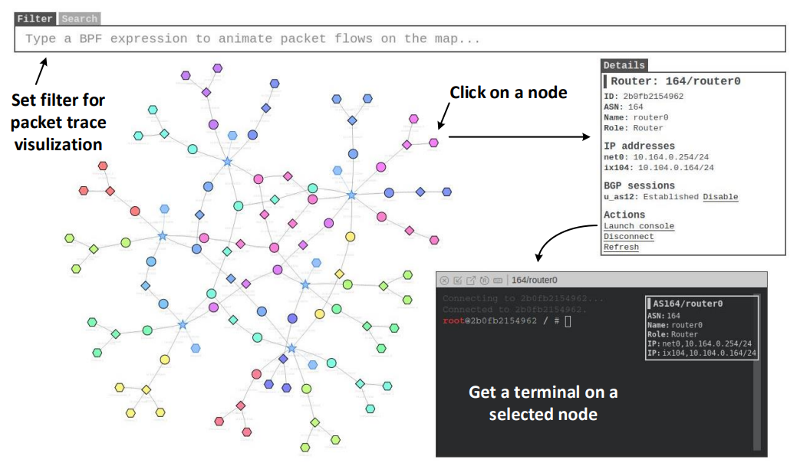
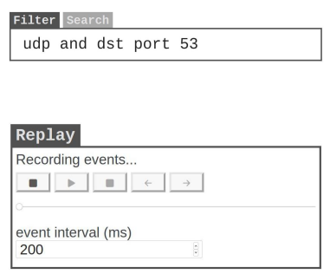
Visualization Tool: the Map

Slide 18
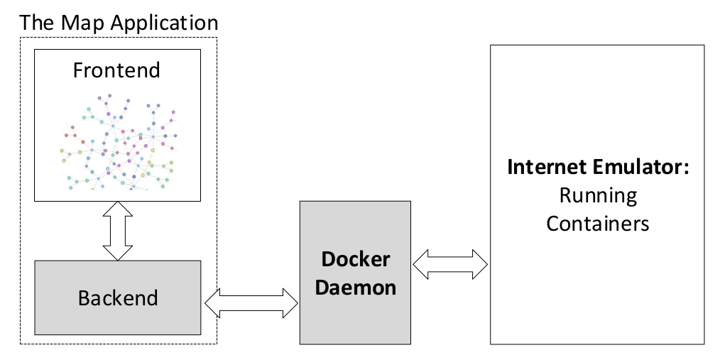
Visualization Tool: Design

Slide 19
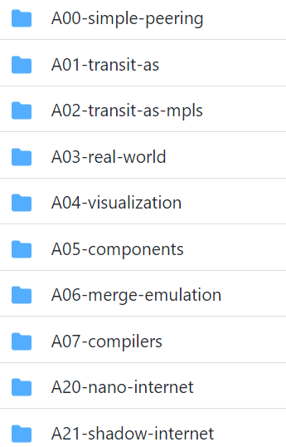
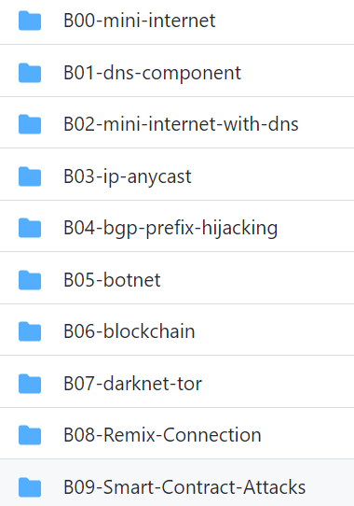
Demo: Building Internet Emulator
Code: inside the examples/ folder

Slide 20
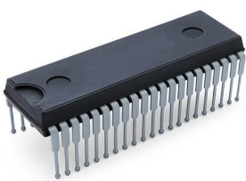
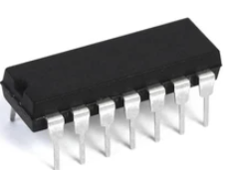
Components

Slide 21
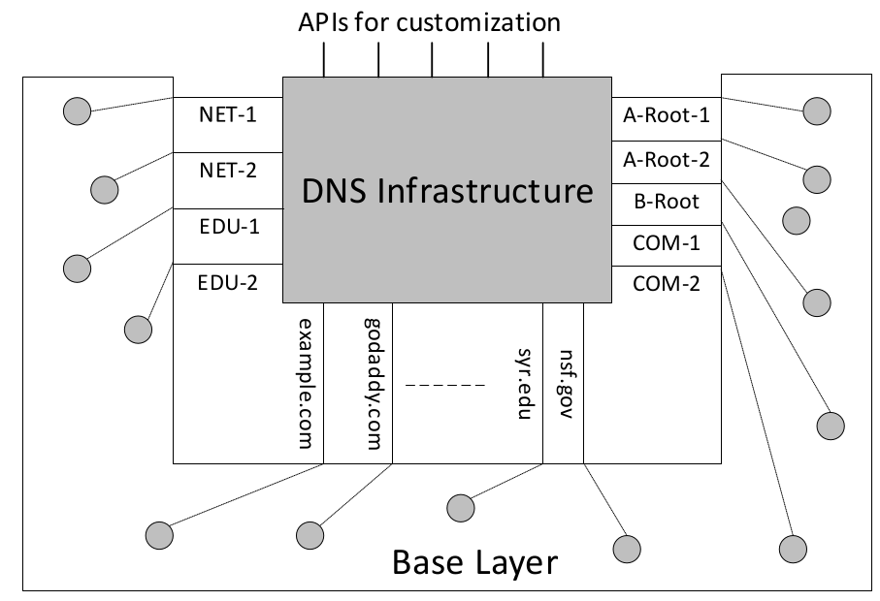
Components
Components (Class + Object)
DNS infrastructure
Botnet
Darknet
A national/state backbone
A company’s networks
Blockchain

Slide 22
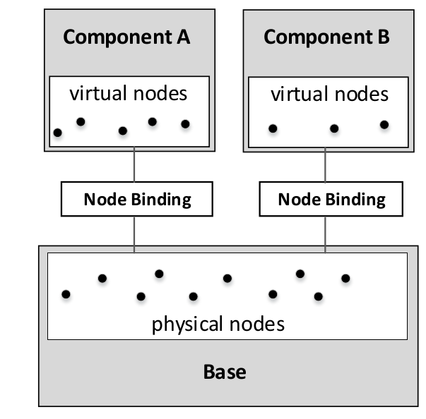
Extensible Design for Components

Slide 23
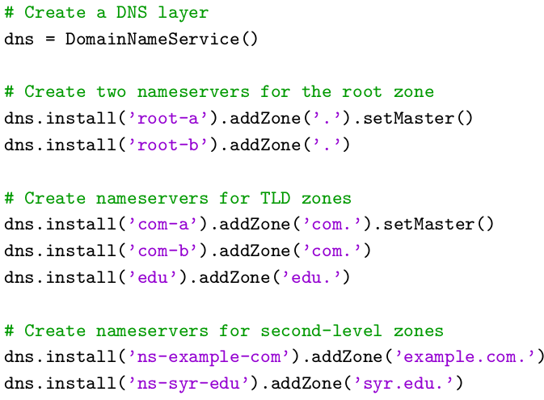
DNS: A Component Example

Slide 24
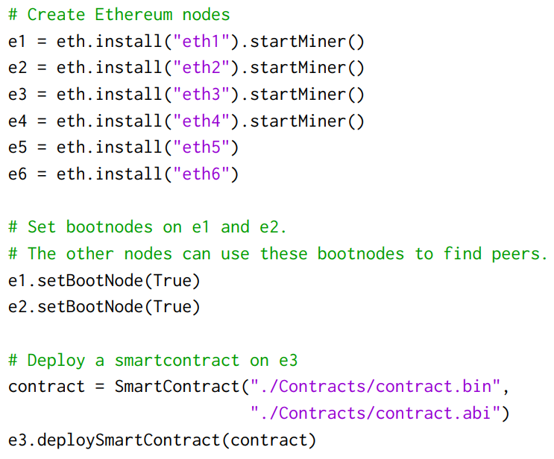
Blockchain Component

Slide 25
Adding Blockchain to Emulator
Host Machine (Ubuntu 20.04 VM)
Mini-Internet
63 machines (containers)
34 networks
6 Internet exchanges
13 stub autonomous systems
5 transit autonomous systems
Blockchain
4 mining nodes
2 non-mining nodes

Slide 26
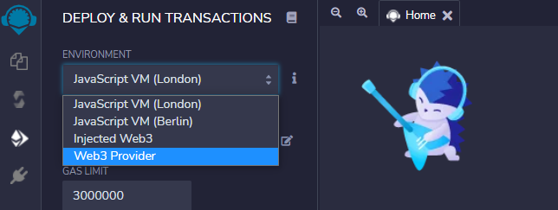
Blockchain: Integrating with Existing Tools

Slide 27
Applications: Labs

Slide 28
Applications
BGP & Attacks
DNS Infrastructure
Botnet
Blockchain
SDN (Software Defined Network)
Morris Worm
Yesterday Once More
CDN (Content Delivery Network)
???
???
Ransomware
Darknet

Slide 29
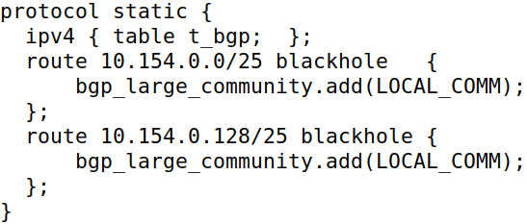
Demo: BGP Attack Lab
2008: Pakistan Hijacked YouTube
Hijack 10.154.0.0/24 (AS-154)
Attacker: AS-161

Slide 30
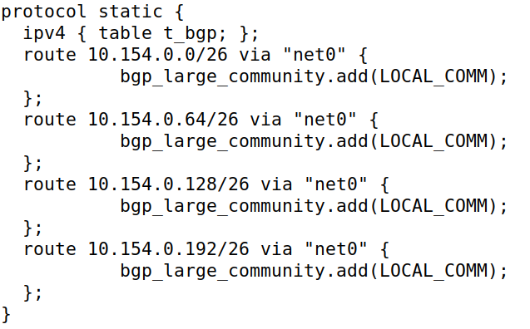
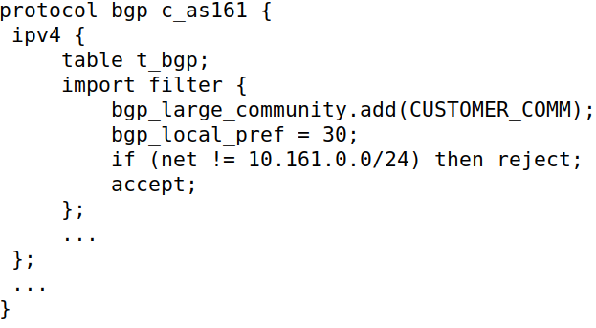
BGP Attack: Fight Back
Fight back (by AS-154)
Block it on upstream ISP

Slide 31
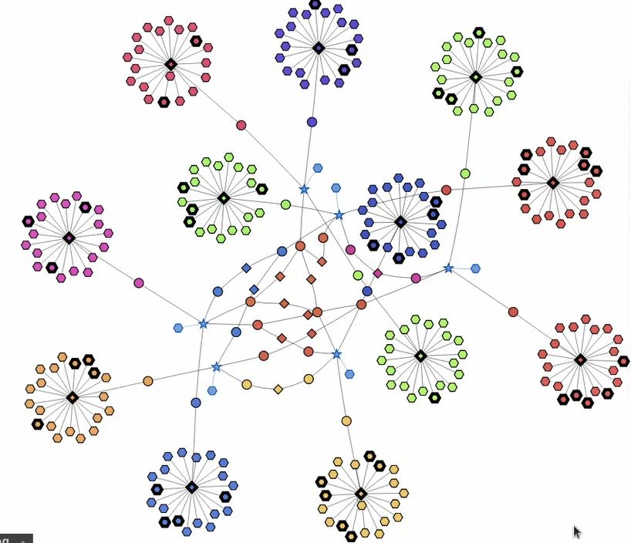
Morris Worm Lab
Demo video https://youtu.be/2VZV-aFoVjk

Slide 32
Performance

Slide 33
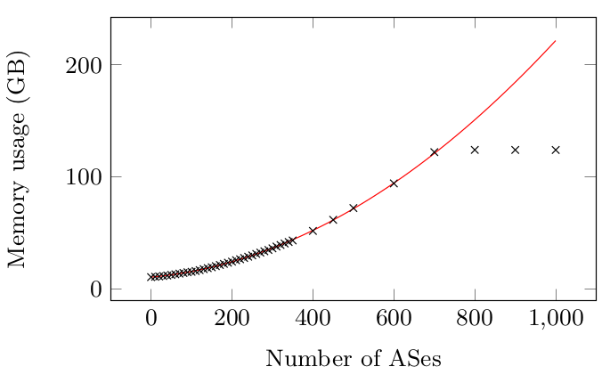
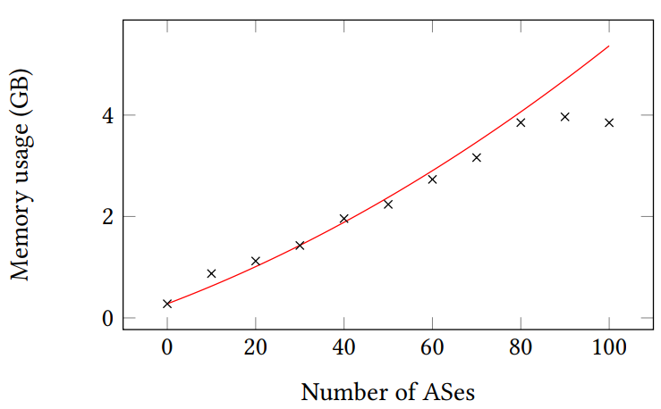
Memory Usage
Powerful Server (20 cores, 120 GB of RAM)
Virtual Machine (2 cores, 4 GB of RAM)

Slide 34
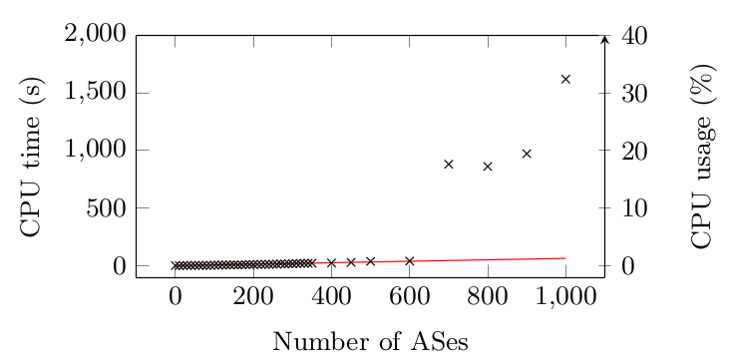
CPU
Powerful Server

Slide 35
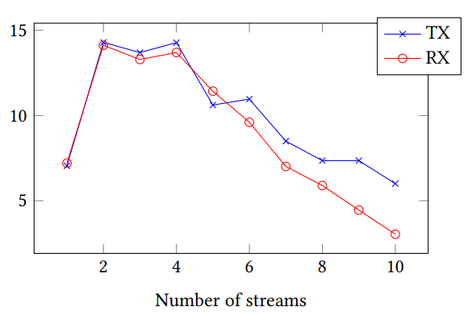
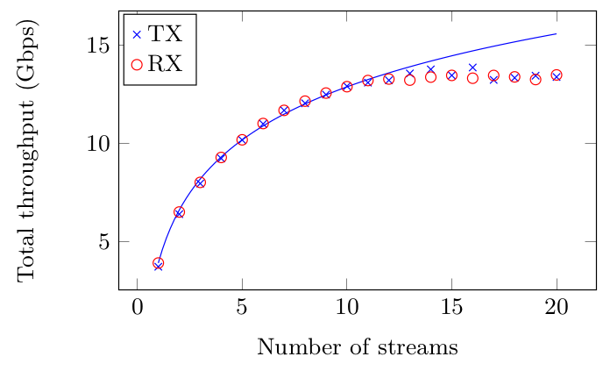
Network Throughput
Powerful Server
Virtual Machine

Slide 36
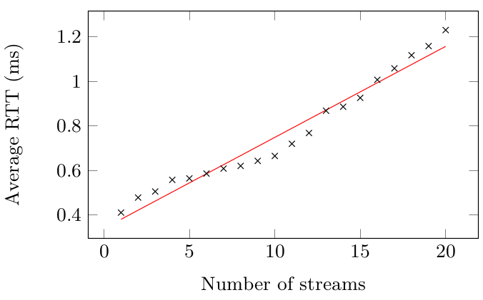
Round Trip Time
Powerful Server

Slide 37
Additional Information

Slide 38
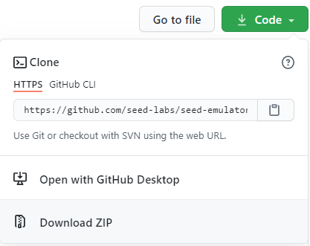
Getting the Code
Download the source code
GitHub: https://github.com/seed-labs/seed-emulator
Set up the development environment
$ source development.env
The examples/ folder

Slide 39
Additional Information
SEED Website: https://seedsecuritylabs.org/

Slide 40
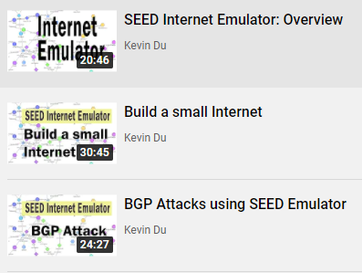
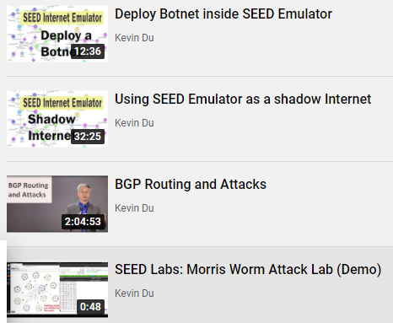
YouTube Videos

Slide 41
Summary
The SEED Internet Emulator
Design
Applications in cybersecurity education
Performance
This is an open-source project
Questions?

